Slide 1
Highway Planning & Design Lecture - 9
Designed and presented
By
Asst. Prof. Dr. Raquim Nihad Zehawi

Slide 2
Location with respect to end of curve
In the tangent-to-circular curve design
Normal practice is to divide the runoff length between the tangent and curved sections and to avoid placing the entire runoff length on either the tangent or the curve

Slide 3
In alignment design with spirals
The length of the superelevation runoff should be equal to the spiral length for the tangent-to-spiral (TS) transition at the beginning and the spiral-to-curve (SC) transition at the end of the circular curve
The change in cross slope “tangent runout” begins on a length of tangent just ahead of (TS)
Between the (TS) and (SC), the spiral curve and the superelevation runoff are coincident and the traveled way is rotated to reach the full superelevation at the (SC)

Slide 4
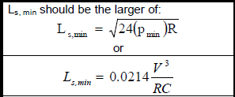
Length of superelevation runoff
In transition design with a spiral curve, it is recommended that the superelevation runoff be accomplished over the length of spiral
For the most part the calculated values for length of spiral and length of runoff do not differ materially
The length of runoff is applicable to all superelevated curves, and it is recommended that this value should be used for minimum lengths of spiral
Full attainment of superelevation is then accomplished over the length of the spiral
the whole of the circular curve has full superelevation

Slide 5
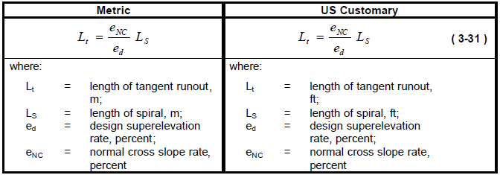
Length of tangent runout (Spiral Curve)

Slide 6
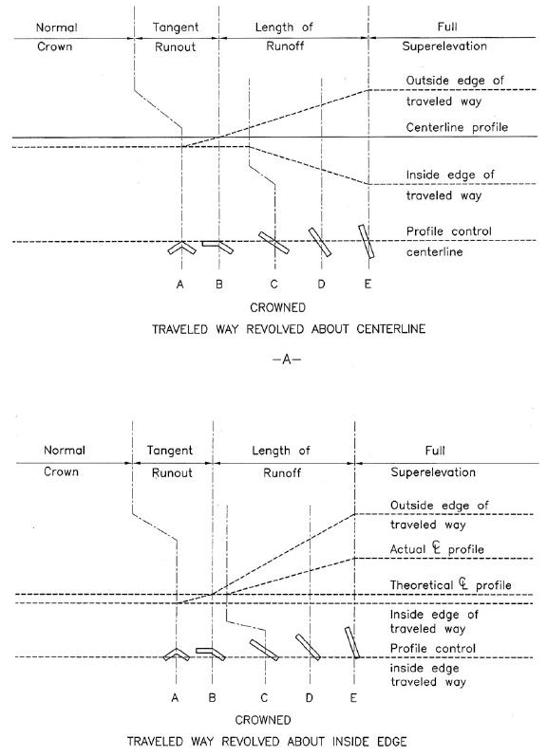
Exhibit 3-37.
Diagrammatic Profiles Showing Methods of Attaining superelevation for a Curve to the Right

Slide 8
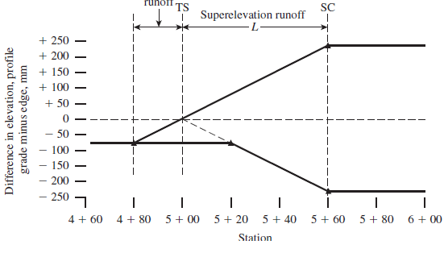

Slide 9
Example 10
What is the minimum radius of curvature allowable for a roadway with a 100 km/h design speed, assuming that the maximum allowable superelevation rate is 0.12?
Compare this with the minimum curve radius recommended by AASHTO
What is the actual maximum superelevation rate allowable under AASHTO recommended standards for a 100 km/h design speed, if the value of f is the maximum allowed by AASHTO for this speed? Round the answer down to the nearest whole percent.
Solution:
Minimum radius of curvature for 100 km/h
Minimum radius recommended by AASHTO is 490 m. Actual maximum superelevation rate for AASHTO recommended standards for 100 km/h is

Slide 10
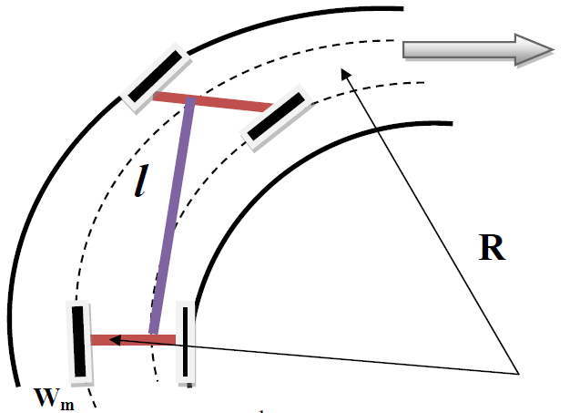
WIDENING ON CURVES
The travelled way on horizontal curves is sometimes widened to make operating conditions on the curve similar to those on tangents
Widening is needed for the following reasons :
1- The vehicle occupies a greater width as
the rear wheel don’t track the front wheel.
2-The driver experience difficulties in steering
around the curve.
The rear wheels follow a shorter radius turning

Slide 11
1.Mechanical widening (Wm)
We = R₂ – R₁
We = R₂ - $\sqrt{{R_{2}}^{2}−L^{2}}$
R₂ – We = $\sqrt{{R_{2}}^{2}−L^{2}}$
L
R
2
(R₂ – We)² = ${R_{2}}^{2}−L^{2}$
$${R_{2}}^{2}+ {W_{e}}^{2}− 2 R_{2} W_{e}= {R_{2}}^{2}−L^{2}$$
w
e
R
1
since the value of (We) is small as compare to R₂ (We²) may be neglected:-
L = wheel base length.
R₁ = radius of the outer following wheel.
R₂ = radius of the outer leading wheel.
R = radius of the curve.
We = extra width of pavement for one lane.
n = number of traffic lanes.
$$2 R_{2} W_{e}=L^{2}$$
$$W_{e}=\frac{L^{2}}{2 R_{2} }= \frac{L^{2}}{2 R }$$
If the number of traffic lanes are (n), then total extra width (Wm)
$$W_{m}=\frac{n L^{2}}{2 R }$$

Slide 12
2. Psychological widening (Wp)
$$W_{p}=\frac{V}{9.5 \sqrt{R}}$$
Total extra width required (Wc)
$$W_{C}=\frac{n L^{2}}{2 R }+ \frac{V}{9.5 \sqrt{R}}$$
$$W_{C}=W_{m}+ W_{P}$$
Example 11
Find the widening necessary for a horizontal curve having R=100m, wheel base =6.1m,
pavement width = 7m, V= 70 km/hr.
Solution:

